Slide 1
Unsupervised Image Segmentation with K-means

Slide 2
PROJECT OBJECTIVE
Image segmentation is the process of partitioning a digital image into multiple segments (sets of pixels, also known as image objects).
The goal of segmentation is to simplify and/or change the representation of an image into something that is more meaningful and easier to analyze.
Image segmentation is typically used to locate objects and boundaries (lines, curves, etc.) in images. More precisely, image segmentation is the process of assigning a label to every pixel in an image such that pixels with the same label share certain characteristics.

Slide 3
Data Overview
In this project we are using 2 datasets:
Dataset 1 (Pets Dataset):
In dataset 1 there are 7,384 images of various breeds of both cats and dogs in multiple poses.
The images come in a wide range of widths and height. The pixels in the original image dataset are values in the range from 0 to 255.
There are no missing values for any of the images in the dataset. For the pixel values there are also no outliers for this image dataset.
Dataset 2 (Drone Dataset):
In dataset 2 there are 400 images captured from a drone that is at a height between five and thirty meters off of the ground.
The original images are all the same size at 6000 x 4000 x 3. The pixels in the original dataset are in the range from 0 to 255.
There are no missing values for any of the images of the drone dataset. There are also no outliers in pixel value or image size with the drone dataset.

Slide 4
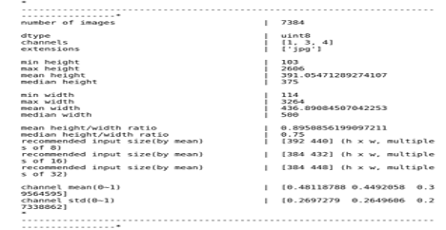
Exploratory Data Analysis - Pets Dataset
Below shows the dtype, how many channels in each image, and basic statistics for image size and pixel values.

Slide 5
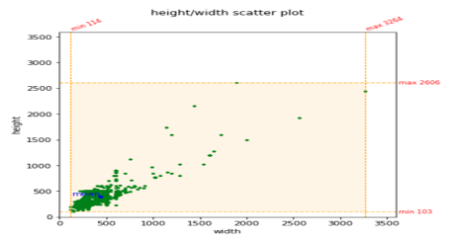
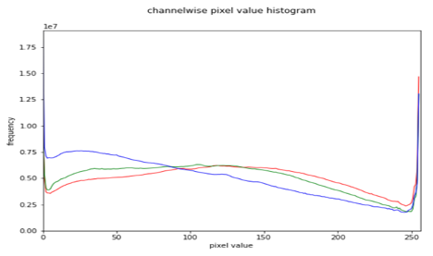
Exploratory Data Analysis - Pets Dataset
The blue channel has the highest deviation of the three channels
Images have a high variation of sizes

Slide 6
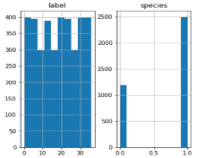
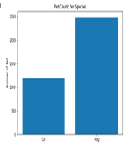
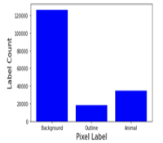
The pixel values are in the range from 0 to 255. The histogram for the class labels is shown below. We can see that the background is the majority of the class labels with over 120,000 pixels representing the background while the outline and animal combined is less than half of that
For the training and test dataset we have 2 graphs which are histogram and bar chart for the counts of species which are Cats and Dogs. There are 3680 entries in the train dataset and 3669 entries in the test dataset.
Exploratory Data Analysis - Pets Dataset

Slide 7
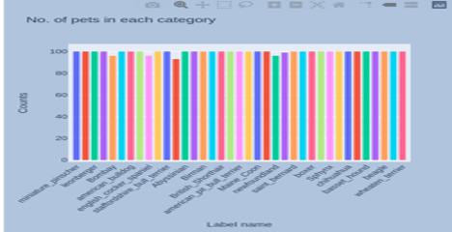
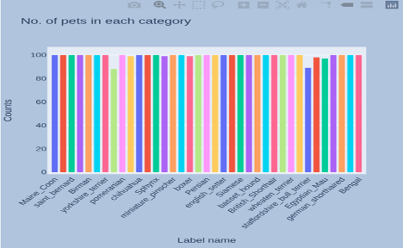
Below two graphs show the counts of the number of pets in each category for both train and test data. And as we can see that the maximum number of pets for almost all categories is 100. This means that the dataset is evenly distributed.
Exploratory Data Analysis - Pets Dataset

Slide 8
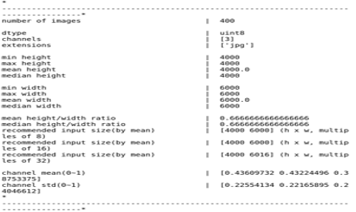
Exploratory Data Analysis - Drone Dataset
The original images are all the same size at 6000 x 4000 x 3.
The pixels in the original dataset are in the range from 0 to 255.
This drone dataset also contains a ground truth masking for each of the images. The values of the pixels in the ground truth masking range from the values of 0 to 23.

Slide 9
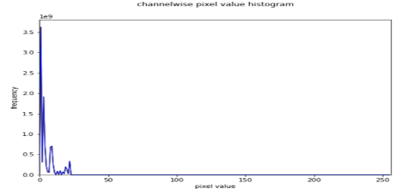
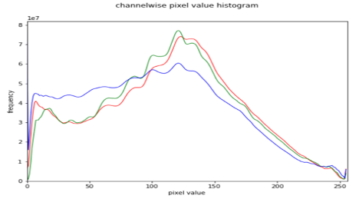
Top graph shows number of times each pixel has a certain class label based off the mask images. 23 different class labels with a few of them being person, vegetation, tree and bicycle.
The original images in the drone dataset have pixel values between 0 and 255. The histogram for the pixel values for each channel is shown to the right.
Exploratory Data Analysis Drone Dataset

Slide 10
K-means Algorithm
Clusters points based on their similarity or closeness to each other. The algorithm has three steps. The first step chooses the initial centroids using random data points. After initialization the first step assigns each sample to its nearest centroid. The second step creates new centroids by taking the mean value of all of the samples assigned to each previous centroid. The difference between the old and the new centroids are computed and the algorithm repeats these last two steps until this value is less than a threshold.
We give the k-means algorithm the number of clusters we want the image to be segmented into. For Pets dataset we give it two for pet and background and Drone dataset we give it five.

Slide 11
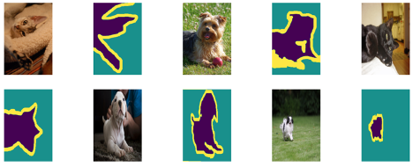
Predictive Modeling for Pets Dataset
Random examples of original images along with their ground truth masks
Mask images have three labels, animal, outline, and background

Slide 12
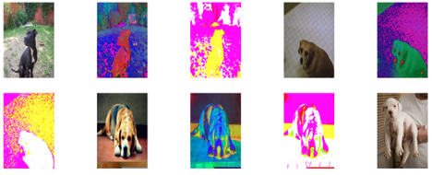
The significance of RGB to HSV values can be defined as:
RGB color space describes colors in terms of the amount of red, green, and blue present. HSV color space describes colors in terms of the Hue, Saturation, and Value. In situations where color description plays an integral role, the HSV color model is often preferred over the RGB model.
The significance of RGB to LAB values can be defined as:
RGB operates on three channels: red, green and blue. Lab is a conversion of the same information to a lightness component L*, and two-color components - a* and b*. Lightness is kept separate from color, so that you can adjust one without affecting the other.
Pet Dataset HSV and LAB Conversion

Slide 13
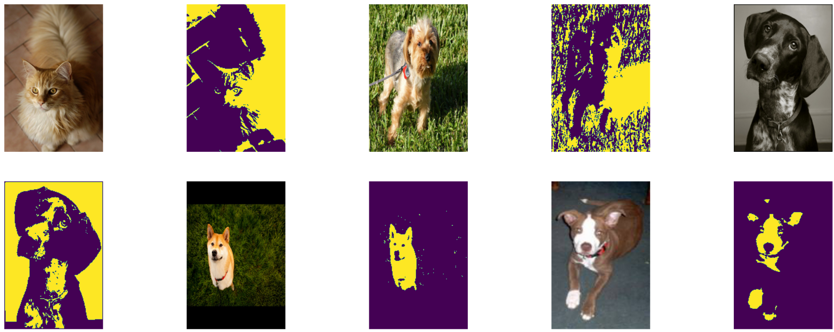
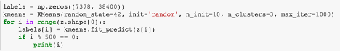
K-means Original, HSV, LAB
Each image has nine channels
K-means segmented images into 2 clusters

Slide 14
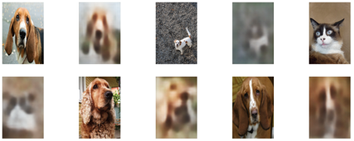
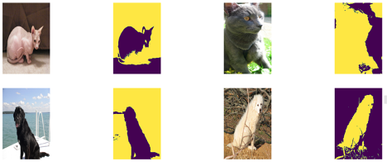
Autoencoders are a specific type of feed-forward neural networks where the input is the same as the output. They compress the input into a lower-dimension and then reconstruct the output from this representation. An autoencoder consists of 2 components, an encoder and decoder. The encoder compresses the input and , the decoder then reconstructs the input from the output of the encoder.
K-means and Autoencoder
Inputs and outputs from the autoencoder
Original images and outputs from k-means

Slide 15
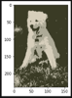
The next step we did was to apply the self-organizing maps (SOM) to the dataset. A SOM is a type of artificial neural network that is trained using unsupervised learning to produce a low-dimensional, discretized representation of the input space. This is a random example of the output from the SOM.
Self-Organizing Maps - Pet Dataset

Slide 16
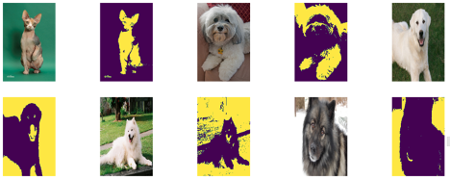
Random original images with output of k-means
Input to k-means was autoencoder output, som output, and original image
Each image has 9 channels
K-means with Autoencoder, SOM, Original Image

Slide 17
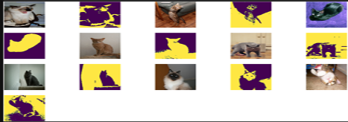
The last attempt was using all features and feeding to the k-means a 15 channel image of the original image, output from autoencoder, output from SOM, hsv conversion of original image, lab conversion of original image.
K-means Original, Autoencoder, SOM, HSV, LAB

Slide 18
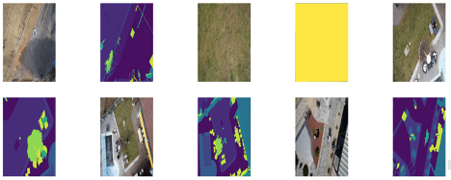
Predictive Modeling for Drone Dataset
In the picture we have random images from the original drone dataset as well as the ground truth masked images.
Ground truth masks have 23 different labels such as trees, grass, rocks, and water

Slide 19
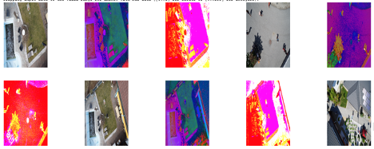
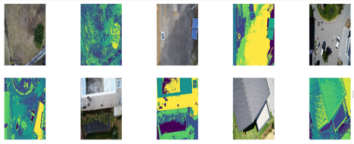
K-means Segmentation with HSV and LAB
Original image
HSV conversion
LAB conversion
After applying K-means
5 clusters

Slide 20
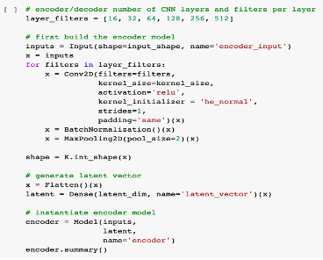
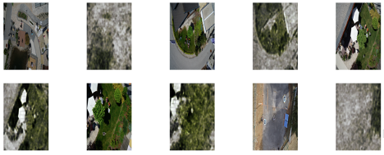
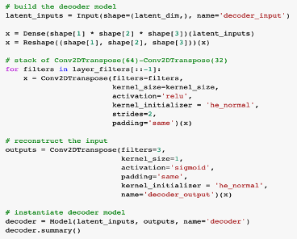
Autoencoder
Original images along with output from the autoencoder

Slide 21
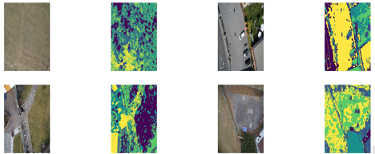
K-means from Autoencoder and Original
To the right we have the original images along with the output from the k-means
K-means given the autoencoder output and the original image

Slide 22
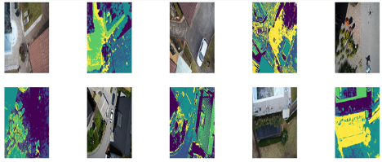
K-means from Autoencoder, SOM, Original
Input to k-means algorithm was a 9 channel image from the original image, output from autoencoder, and output from SOM. K-means clustered the image to 5 clusters.

Slide 23
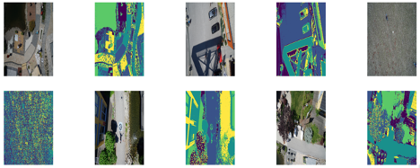
K-means With All Features
K-means given an image with 15 dimensions
Original image, HSV conversion, LAB conversion, Autoencoder output, self-organizing maps output
K-means given 5 as the number of clusters

Slide 24
References and GitHub
https://www.robots.ox.ac.uk/~vgg/data/pets/
http://dronedataset.icg.tugraz.at
https://github.com/MWesner3344/DSCI-592

Slide 25
THANK YOU!
ANY QUESTIONS?

